Slide 1
E-learning Platform
Andy DiCarlo and Nick Bava

Slide 2
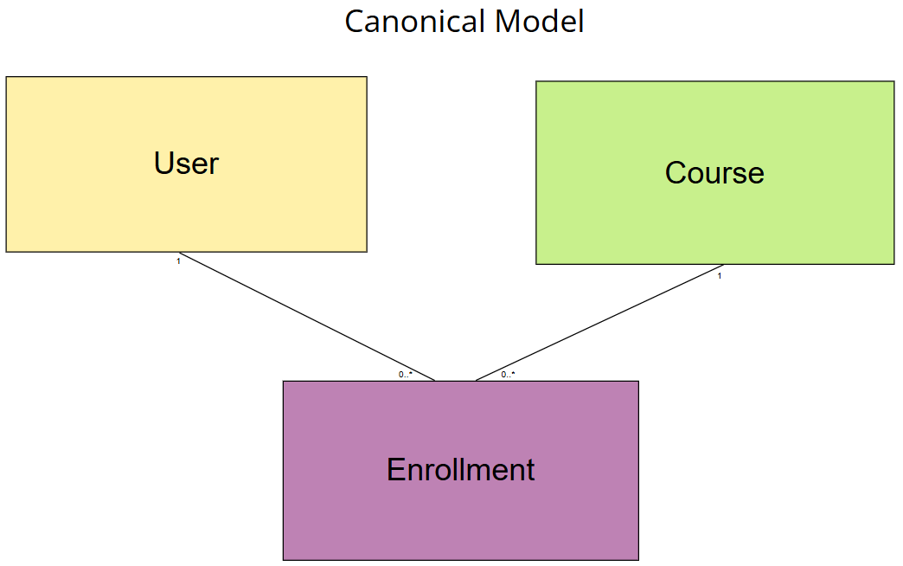
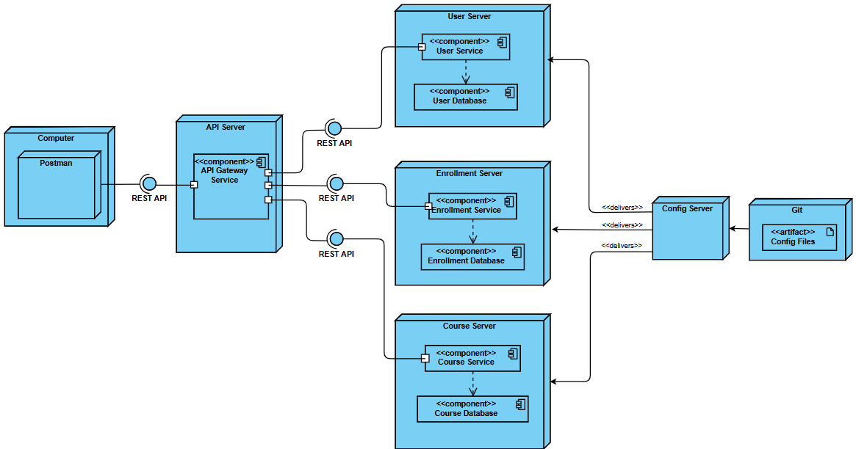
Theme
We are building an E-Learning Platform using a Cloud-Native architecture with Java Spring
Business: Project consists of 3 microservices: User Service, Course Service, and Enrollment Service
Configuration: An additional microservice called Configuration Server will centralize environment configuration
Additional Services: Have now added Eureka Server, Gateway Server, and Keycloak into the architecture
Application will be deployed using containerization.

Slide 3
Containerization
Docker is used to build images of the microservices and run each in its own container
Each microservice has its own Dockerfile, with arguments pointing to the JAR file
A central docker directory within the project has a compose.yaml file to dictate the build and run of the images and containers of the microservices and associated databases

Slide 4
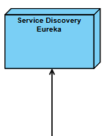
API Gateway
Creates single entry point to reach our services
Routes requests to the appropriate microservice
Handles cross-cutting concerns like authentication

Slide 5
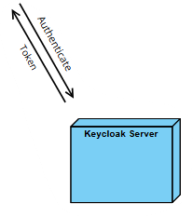
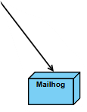
Eureka Server
Using Netflix Eureka for service discovery
Enables automated service registration and discovery
Improves load balancing and fault tolerance
Maintain dynamic registry of all microservices

Slide 6
Resilience4j
Addition of several resilience features
Circuit Breaker
Retry
Rate Limiter
Bulkhead (Semaphore)

Slide 7
Keycloak
Set up elearn-realm
Manage USER and ADMIN privileges within our system
Obtain access token from OpenID Connect
Allow for password reset with Mailhog

Slide 11
Kafka – User Topic
Publish
Subscribe
Subscribe
Kafka – Course Topic
Publish

Slide 12
Ingest & Aggregate
ELK Stack
Kafka – User Topic
Logstash
Publish
Index
Subscribe
Elasticsearch
Analyze
Kibana
Subscribe
Kafka – Course Topic
Publish
Flow Visualization
Zipkin

Slide 13
AWS
RDS - PostgreSQL
EKS
ECR Image Pull
Enrollment
Services with External Exposure – Nodeport / Load Balancer
Kubernetes Helm Install
Gateway
Keycloak
Keycloak - Service
Kibana
Zipkin
Enrollment DB
Course
Eureka
Elasticsearch
Logstash
Kafka
User
Init.sql
Course DB
Zookeeper
PG Admin
Query
Data.sql
Deployment & Service YAML
User DB
Tag & Push
Docker

